Slide 1
Unit 3
Image Restoration and Compression

Slide 2
Image Restoration
Image Restoration is a family of inverse problems for obtaining a high quality image from a corrupted input image
The purpose of image restoration is to "compensate for" or "undo" defects which degrade an image.
Degradation comes in many
motion blur
noise, and
camera miss-focus.
In cases like motion blur, it is possible to come up with an very good estimate of the actual blurring function and "undo" the blur to restore the original image.
In cases where the image is corrupted by noise, the best we may hope to do is to compensate for the degradation it caused.

Slide 3
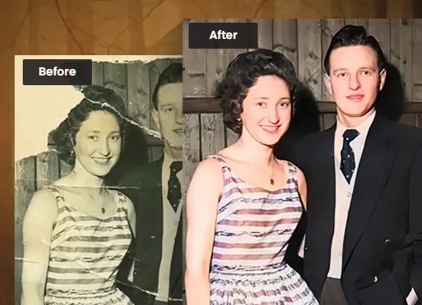
Cot..

Slide 4
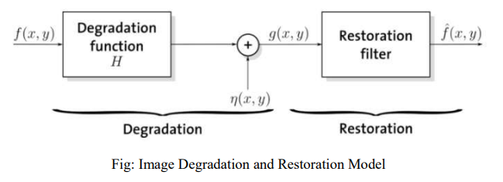
Models for Image degradation and restoration process
The input image f(x,y) is processed by degradation function H, that together with an additive noise term n(x,y) to produce degraded image g(x,y). the g(x,y) consist of some knowledge about noise term n(x,y) and some knowledge about degradation function H. The objective of image restoration is to obtain an estimate of original image f(x,y). Here, by some knowledge of H and n(x,y), we find the appropriate restoration filters, so that output image f’(x,y) is as close as original image f(x,y). Since, it is practically not possible (or very difficult) to completely restore the original image.
In Spatial Domain
Degraded image is represented by
g(x,y) = h(x,y) * f(x,y) + n(x,y)
Where,
h(x,y) = Degradation function
* = Indicates the convolution operation
f(x,y) = Original Image
g(x,y) = Degraded image
n(x,y) = additive noise term

Slide 5
In Frequency Domain
Degraded image is represented by
G(u,v) = H(u,v) * F(u,v) + N(u,v)
If the restoration filter applied is R(u,v)
then,
F’(u,v) = R(u,v) [G(u,v)]
F’(u,v) = R(u,v) H(u,v) F(u,v) + R(u,v) N(u,v)
F’(u,v) F(u,v)
Where, F’(u,v) is the restored image
Here, restoration filter
R(u,v) is the reverse of degradation function H(u,v).

Slide 6
Noise Models
Noise tells unwanted information in digital images.
Noise produces undesirable effects such as artifacts, unrealistic edges, unseen lines, corners, blurred objects and disturbs background scenes.
To reduce these undesirable effects, prior learning of noise models is essential for further processing.
Digital noise may arise from various kinds of sources such as
Charge Coupled Device (CCD) and Complementary Metal Oxide Semiconductor (CMOS) sensors
In some sense, points spreading function (PSF) and modulation transfer function (MTF) have been used for timely, complete and quantitative analysis of noise models.
Probability density function (PDF) or Histogram is also used to design and characterize the noise models.

Slide 7
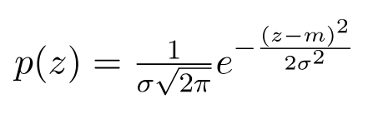
Gaussian Noise
It is also called as electronic noise because it arises in amplifiers or detectors. Gaussian noise caused by natural sources such as thermal vibration of atoms and discrete nature of radiation of warm objects.
Because of its mathematical simplicity, the Gaussian noise model is often used in practice and even in situations where they are marginally applicable at best. Here, m is the mean and σ² is the variance.
Gaussian noise generally disturbs the gray values in digital images. That is why Gaussian noise model essentially designed and characteristics by its PDF or normalizes histogram with respect to gray value. This is given as

Slide 8
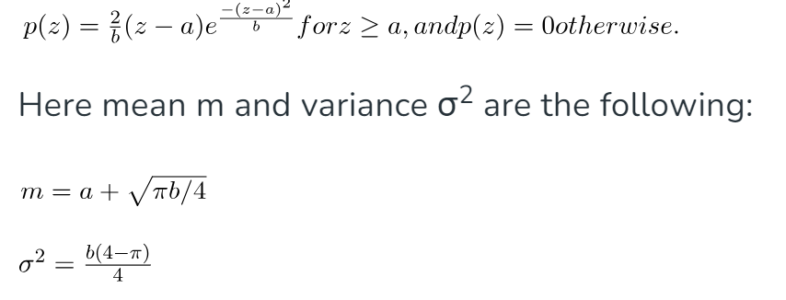
Rayleigh Noise
Rayleigh noise is usually used to characterize noise phenomena in range imaging.

Slide 9
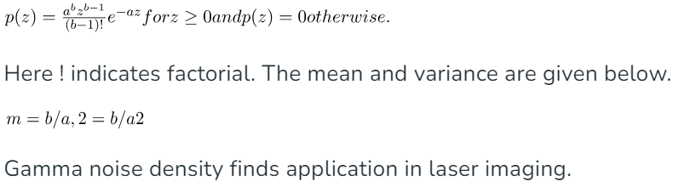
Erlang (or gamma) Noise

Slide 10
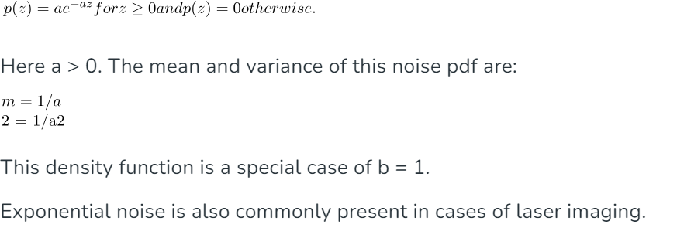
Exponential Noise

Slide 11
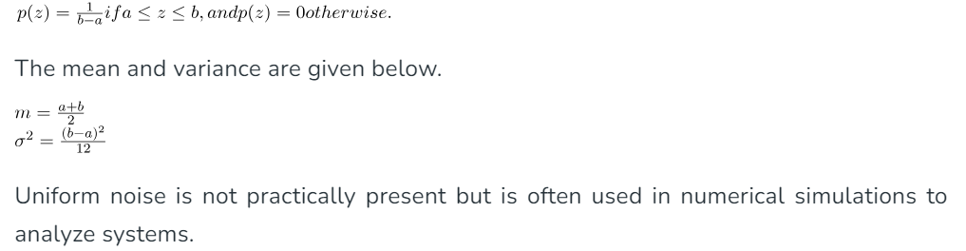
Uniform Noise

Slide 12
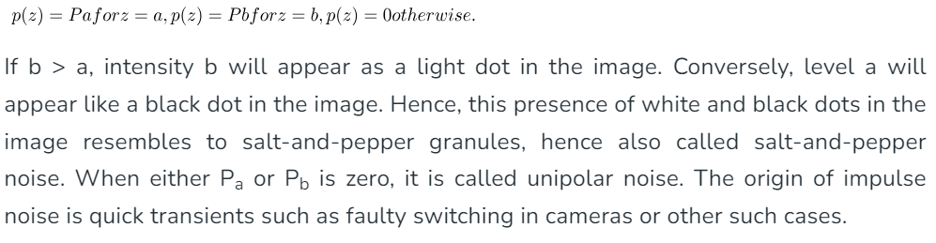
Impulse Noise

Slide 13
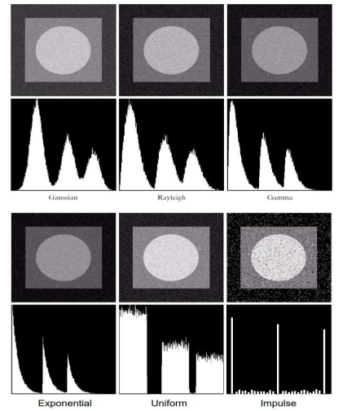

Slide 14
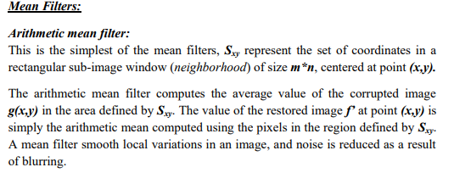
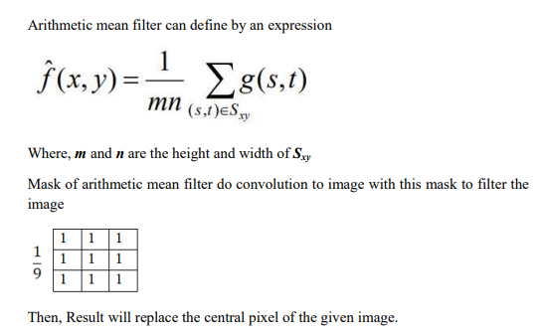
Restoration Filters

Slide 15
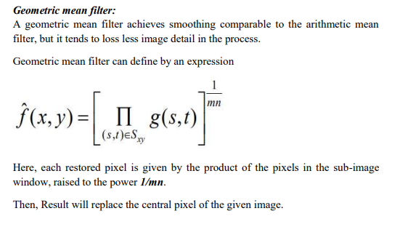
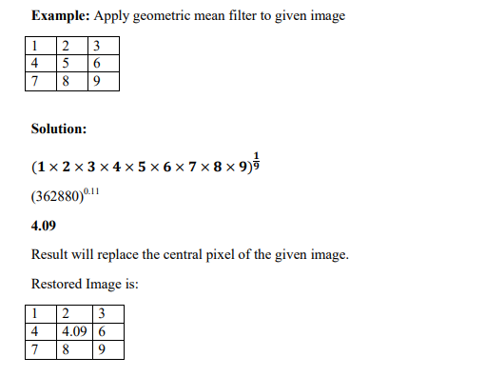

Slide 16
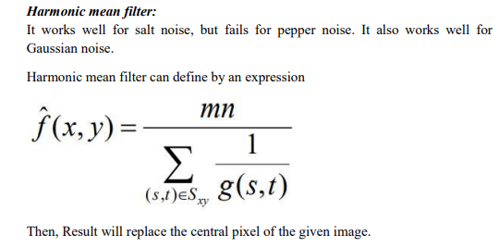
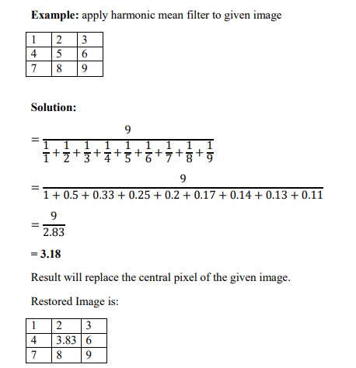

Slide 17
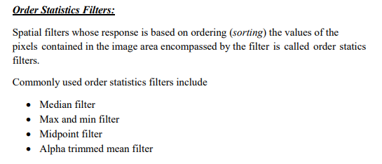
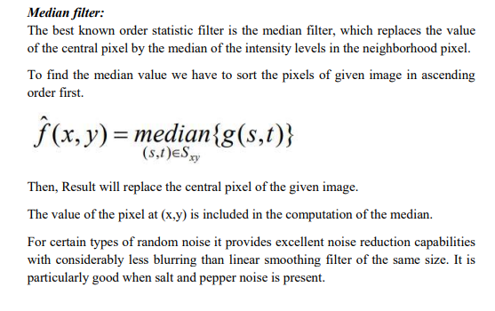

Slide 18
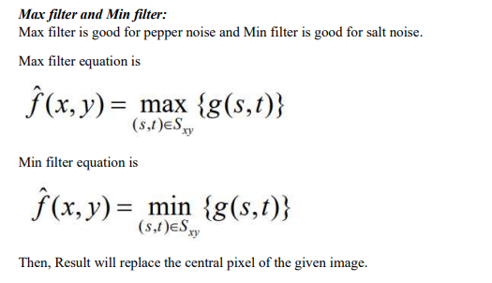
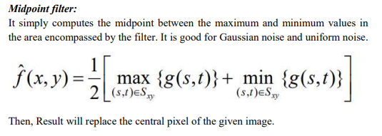
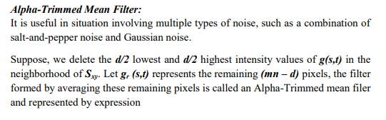
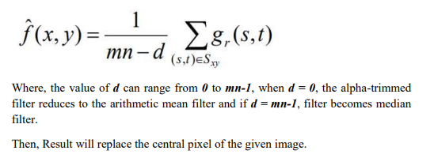

Slide 19
Band rejected Filters
A band reject filter is useful when the general location of the noise in the frequency domain is known. A band reject filter blocks frequencies within the chosen range and lets frequencies outside of the range pass through.

Slide 20
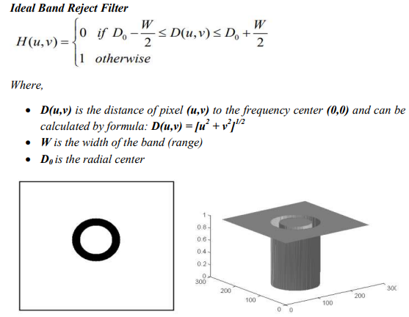
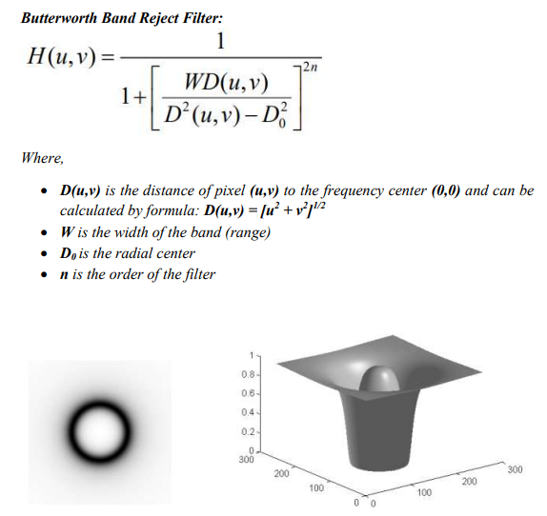

Slide 21
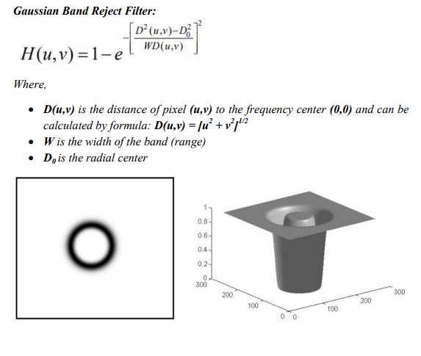

Slide 22
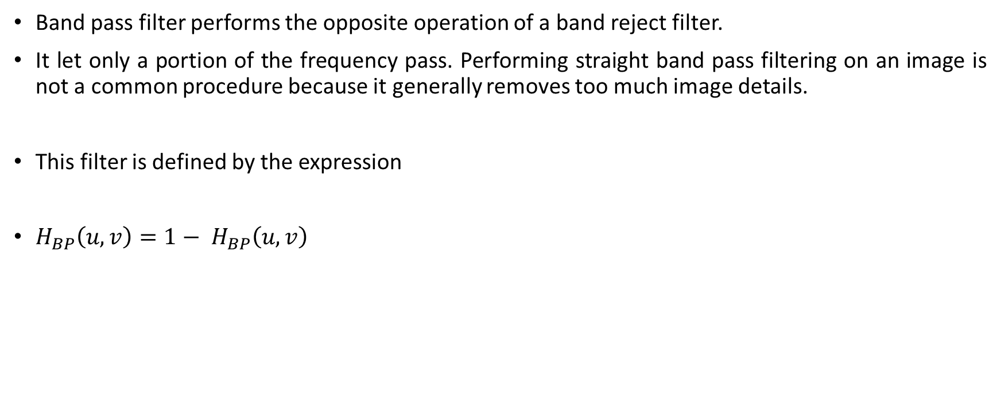
Band pass Filters
Band pass filter performs the opposite operation of a band reject filter.
It let only a portion of the frequency pass. Performing straight band pass filtering on an image is not a common procedure because it generally removes too much image details.
This filter is defined by the expression
$H_{BP}\left(u,v\right)=1− H_{BP}\left(u,v\right)$

Slide 23
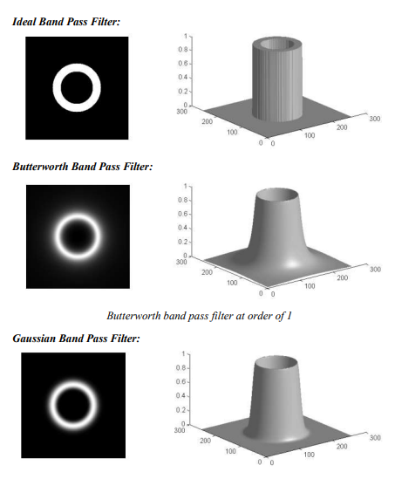

Slide 24
Image Compression
Image compression involves reducing the file size of an image while maintaining as much of its quality as possible.
This is useful for saving storage space and improving the performance of websites and applications.
There are two main types of image compression
Lossy Compression
Lossless Compression:

Slide 25
Why image compression important?
Compressed images load faster than uncompressed images. This matters because the speed at which webpages and applications load has a huge impact on SEO, conversion rates, the user's digital experience, and other crucial metrics. Improving web performance is one of the major ways that developers optimize websites.
Image compression is typically used alongside other methods for improving web performance as well. For instance, a CDN caches content to deliver it more quickly to end users. Load balancing helps prevent web servers from becoming overloaded. The use of lazy loading can allow the most important content of a webpage to load even faster. Overall, however, image compression is often one of the quickest ways of fixing slow page performance.

Slide 26
Lossy Compression and Lossless Compression
S.NO | Lossy Compression | Lossless Compression
1. | Lossy compression is the method which eliminate the data which is not noticeable. | While Lossless Compression does not eliminate the data which is not noticeable.
2. | In Lossy compression, A file does not restore or rebuilt in its original form. | While in Lossless Compression, A file can be restored in its original form.
3. | In Lossy compression, Data’s quality is compromised. | But Lossless Compression does not compromise the data’s quality.
4. | Lossy compression reduces the size of data. | But Lossless Compression does not reduce the size of data.

Slide 27
. | Algorithms used in Lossy compression are: Transform coding, Discrete Cosine Transform, Discrete Wavelet Transform, fractal compression etc. | Algorithms used in Lossless compression are: Run Length Encoding, Lempel-Ziv-Welch, Huffman Coding,Arithmetic encoding etc.
6. | Lossy compression is used in Images, audio, video. | Lossless Compression is used in Text, images, sound.
7. | Lossy compression has more data-holding capacity. | Lossless Compression has less data-holding capacity than Lossy compression technique.
8. | Lossy compression is also termed as irreversible compression. | Lossless Compression is also termed as reversible compression.

Slide 28
Image compression models
Compression has two types i.e. Lossy and Lossless technique.
A typical image compression system comprises of two main blocks An Encoder (Compressor) which is a software application used to compress an image and Decoder (Decompressor) which is a software application used to de-compress an image.
The image f(x,y) is fed to the encoder which encodes the image to make it suitable for transmission.
The decoder receives this transmitted signal and reconstructs the output image f’(x,y).
If the system is an error free the image f’(x,y) will be a replica of f(x,y).
Input and output function f(x,y,t) and f’(x,y,t) respectively are used for video application where t specified the time.

Slide 29
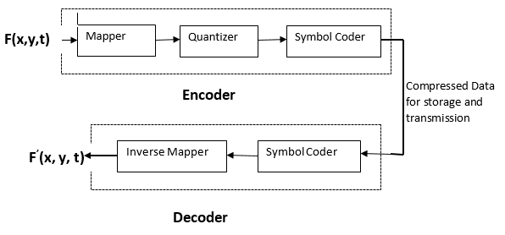

Slide 30
Encoder (Compressor):
The three basic types of the redundancies in an image are interpixel, coding redundancies and psychovisual redundancies. Run length coding is used to eliminate or reduce inter-pixel redundancies, Huffman encoding is used to eliminate or reduce coding redundancies and psychovisual is used to eliminate interpixel redundancies. The input image is passed through a Mapper. The mapper reduces the interpixel redundancies. The mapping stage is a lossless technique and hence is a reversible operation. Run-length coding is used to compress the image in this stage. The output of a mapper is passed to a Quantizer block. The quantizer block reduces the psychovisual redundancies. It compresses the data by eliminating some redundant information and hence is an irreversible operation. The quantizer block uses JPEG compression which means a lossy compression. Hence in case of lossless compression, the quantizer block is omitted.
The final block of the encoder is Symbol Coder. This block creates a variable length code to represent the output of the quantizer. The shortest code length is used for most frequent quantizer output to reduce coding redundancy. This operation is reversible. The Huffman code is a typical example of the symbol coder.
Decoder (De-compressor): The Symbol Decoder and Inverse Mapper of decoder block perform exactly the reverse operation of the symbol coder and the mapper blocks respectively. It is important to note that the decoder has only two blocks. Since quantization is irreversible hence, an inverse quantizer block does not exist.

Slide 31
standards and coding Techniques
Image compression is a process that makes image files smaller. Image compression most often works either by removing bytes of information from the image, or by using an image compression algorithm to rewrite the image file in a way that takes up less storage space.
Compressing an image is an effective way to ensure that the image loads quickly when a user interacts with a website or application. It is an important part of image optimization.

Slide 32
Inter-pixel Redundancy (Run Length Coding)
It is a simplest data compression technique. It is a form of lossless data compression in which runs of data (sequences in which the same data value occurs in many consecutive data elements) are stored as a single data value and count, rather than as the original run. This is most useful on data that contains many such runs.
The general idea behind this method is to replace consecutive repeating occurrences of a symbol by one occurrence of the symbol followed by the number of occurrences.
Example 1: Suppose string is AAAAAAA then Run-length encoding is A7 (A is character and 7 is number of times appear that string)
Example 2: If input string is “WWWWAAADEXXXXXX” then the Run-length encoding is W4A3D1E1X6.

Slide 33
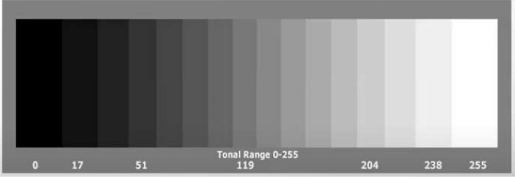
Psychovisual Redundancy (4-bit Improved Gray Scale Coding: IGS Coding Scheme)
The tendency of certain kinds of information to be relatively unimportant to the human visual system, The Psychovisual redundancies exist because human perception does not involve quantitative analysis of every pixel or luminance value in the image. During human eye visualization certain information can be eliminated without significantly degrading image quality. For example:
Here, in the above image, there are different levels of shades, human eyes can't differentiate all the shades like gray scale 253, 254, and 255 are like same so, 253 and 254 can illuminate and replace by 255.

Slide 34
Coding Redundancy (Huffman Coding):
Huffman coding is one of the basic lossless compression methods that have proven useful in image and video compression standards. When applying Huffman encoding technique on an Image, the source symbols can be either pixel intensities of the Image, or the output of an intensity mapping function.
The first step of Huffman coding technique is to reduce the input image to a ordered histogram, where the probability of occurrence of a certain pixel intensity value is as
Probability of Pixel = Number of Pixel / Total Number of Pixel
Where, Number of Pixel is the number of occurrence of a pixel with a certain intensity value and Total Number of Pixel is the total number of pixels in the input Image.
Build a Huffman Tree:
1. Combine the two lowest probability leaf nodes into a new node.
2. Replace the two leaf nodes by the new node and sort the nodes according to the new probability values.
3. Continue the steps (a) and (b) until we get a single node with probability value 1.0. We will call this node as root
Calculate Huffman Code: Backtrack from the root, assigning „0‟ to left child and „1‟ to the right child in each intermediate node, till we reach the leaf nodes. Then assemble the code 0 and 1 from root to pixel position

Slide 35
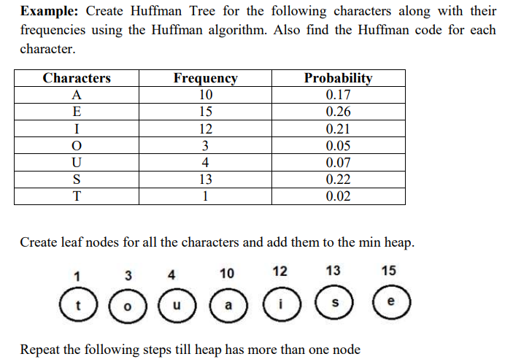

Slide 36
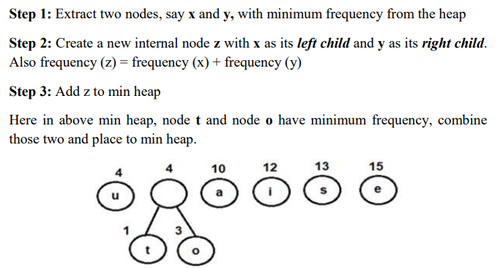

Slide 37
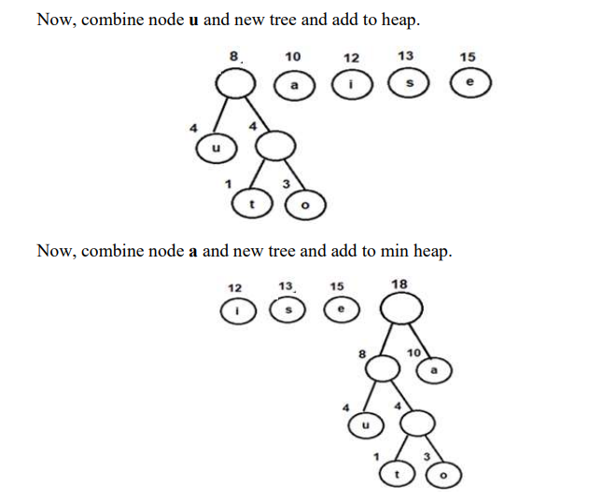

Slide 38
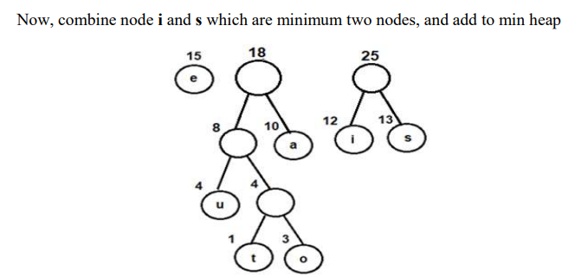

Slide 39
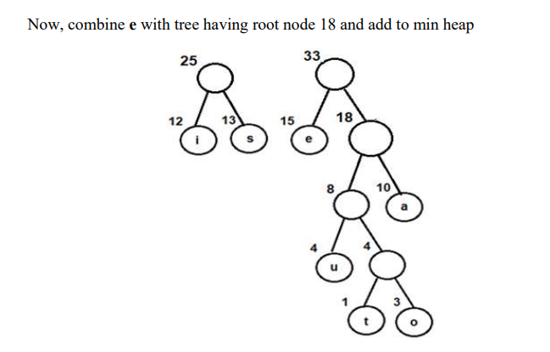

Slide 40
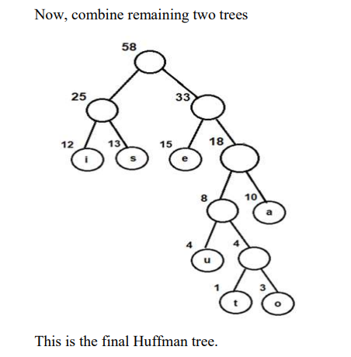

Slide 41
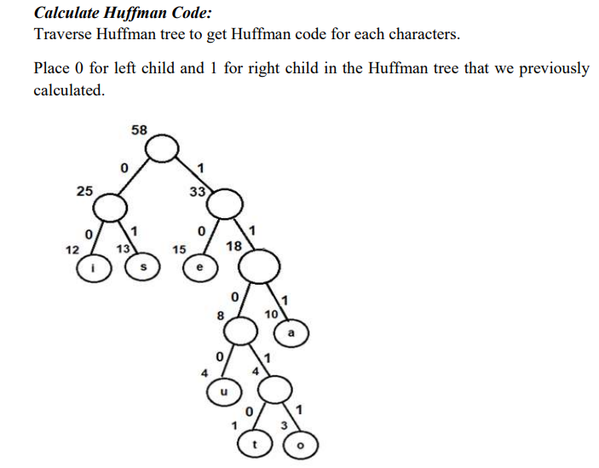
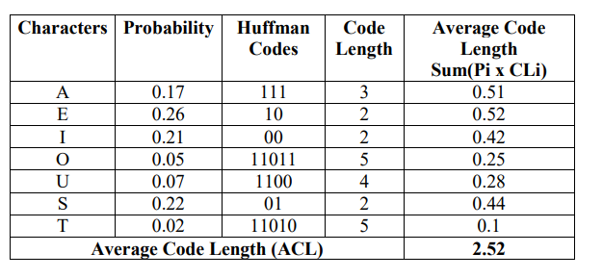

Slide 42
Shannon-Fano Algorithm for Data Compression
Create a list of probabilities or frequency counts for the given set of symbols so that the relative frequency of occurrence of each symbol is known.
Sort the list of symbols in decreasing order of probability, the most probable ones to the left and the least probable ones to the right.
Split the list into two parts, with the total probability of both parts being as close to each other as possible.
Assign the value 0 to the left part and 1 to the right part.
Repeat steps 3 and 4 for each part until all the symbols are split into individual subgroups.

Slide 43
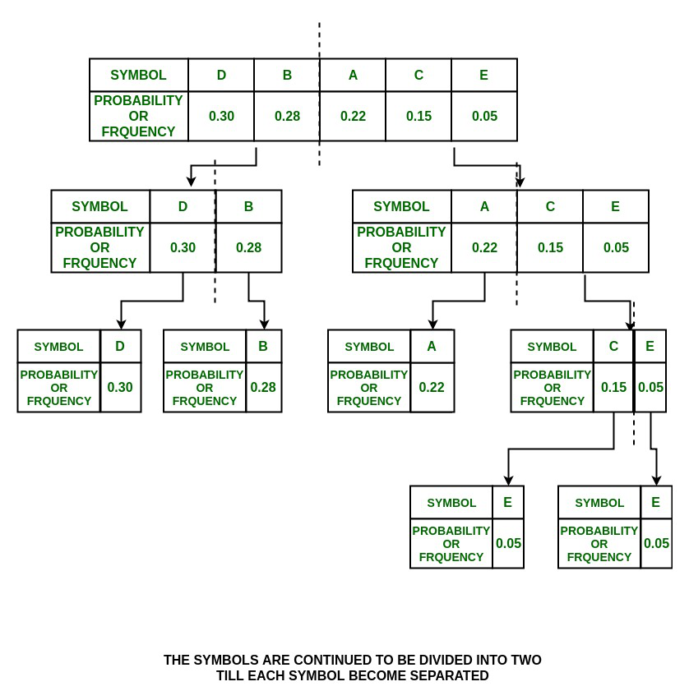
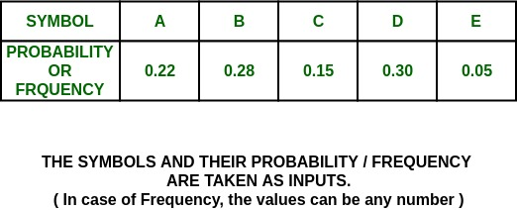

Slide 44
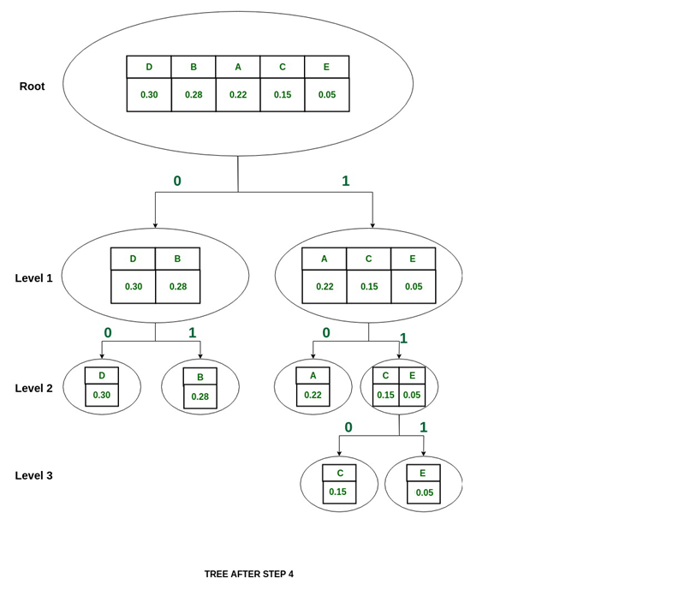
SYMBOL | A | B | C | D | E
PROBABILITY | 0.22 | 0.28 | 0.15 | .30 | .05
SHANNON CODE: | 10 | 01 | 110 | 00 | 111

